Slide 1
The Indian academy of science
Biometric surveillance system
With
Face and Gait recognition
By : Anisha Swain
Guided by: Dr. Geetika Jain Saxena

Slide 2
8 weeks 56 days

Slide 3
Week 1
Addition of noise to images
Removal of noise with filters
Fourier & inverse transform
Transformation of images
Edge detection
Template matching
Key point / feature points extraction

Slide 4
Addition of noise
Image noise is random (not present in the object imaged) variation of brightness or color information in the images captured.
There are typically 3 types of noise. Photoelectronics, Impulse and structured noise
Impulse noise
Gaussian noise
Poisson noise
Speckle noise

Slide 5
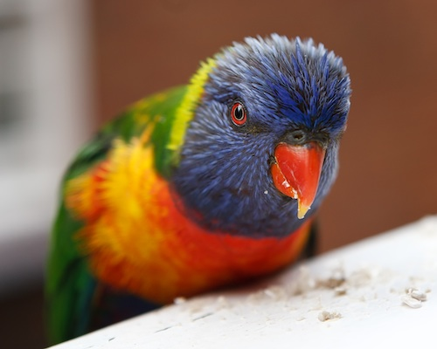
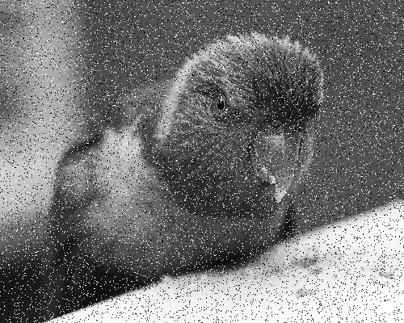
Impulse noise
Salt and pepper noise

Slide 6

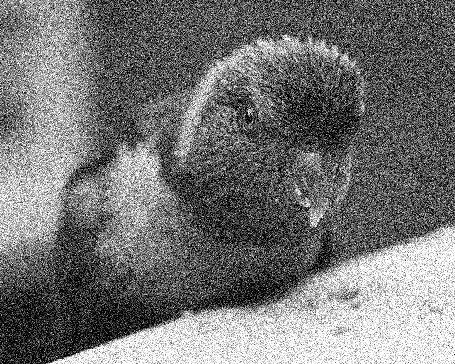
Gaussian noise
Gaussian noise is statistical noise having a probability density function (PDF) equal to that of the normal distribution

Slide 7
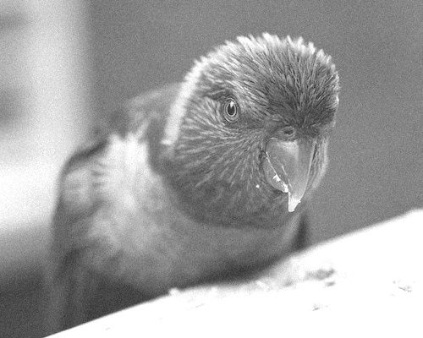
Poisson noise
Shot noise or Poisson noise is a type of electronic noise which can be modelled by a Poisson process. In electronics

Slide 8
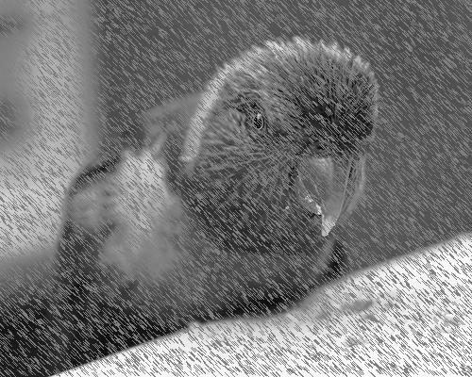
Speckle noise
Poisson noise was generated by multiplying random pixel values with each pixel value of image as it is a granular noise.

Slide 9
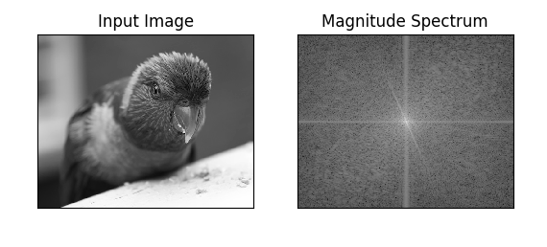
Implementation of Fourier transform
The Fourier Transform is an important image processing tool which is used to decompose an image into its sine and cosine components
The output of the transformation represents the image in the Fourier or frequency domain

Slide 10
Removal of noise with filters
The mean filter is a simple sliding-window spatial filter that replaces the centre value in the window with the average (mean)
The median filter is also a sliding-window spatial filter, but it replaces the centre value in the window with the median of all the pixel values in the window
In image processing, a Gaussian blur (also known as Gaussian smoothing) is the result of blurring an image by a Gaussian function
Bilateral Filter uses Gaussian Filter but it has also one more (multiplicative) Gaussian filter component which is a function of pixel intensity difference.
Mean Filter
Median Filter
Gaussian Filter
Bilateral Filter

Slide 11
Filter
Time domain
Frequeny Domain
Time Domain
Mean
Median
Gaussian
Bilateral
Weiner
Frequency Domain
Fourier Transform
Wavelet Transform
LPF
HPF
LPF
HPF

Slide 12
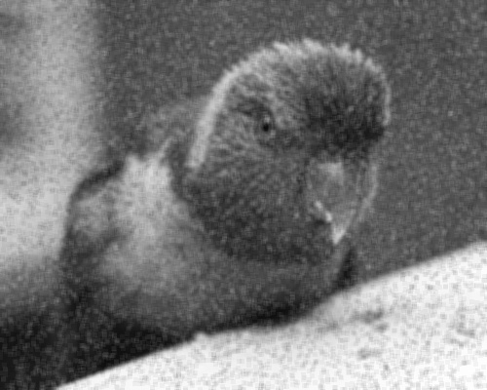

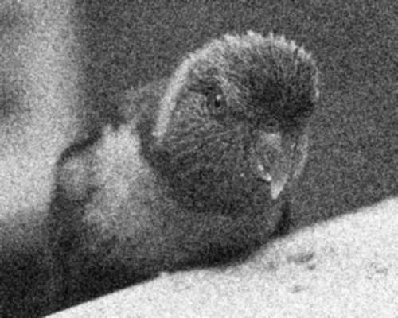
Mean Filtered
Median Filtered
Gaussian Filtered
Bilateral Filtered

Slide 13
Noise | Best Suited Filters
Salt and Pepper | Median
Poisson | Mean
Gaussian | Gaussian
Speckle | Weiner

Slide 14
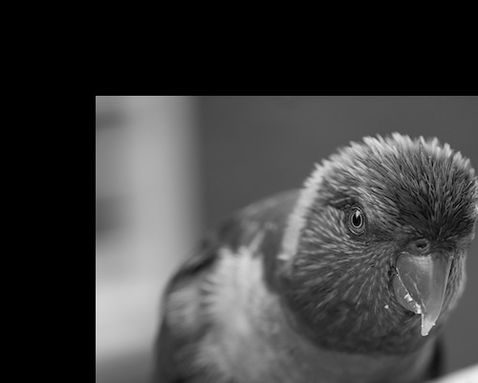
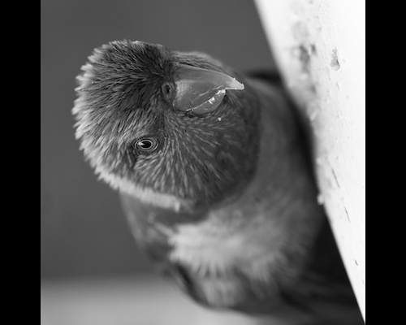
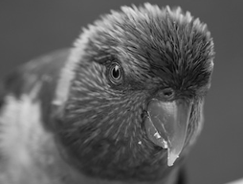
Geometric transformation of images
Translation
Scaling
Rotation
Cropping
Translation
Scaling
Rotation
Cropping

Slide 15
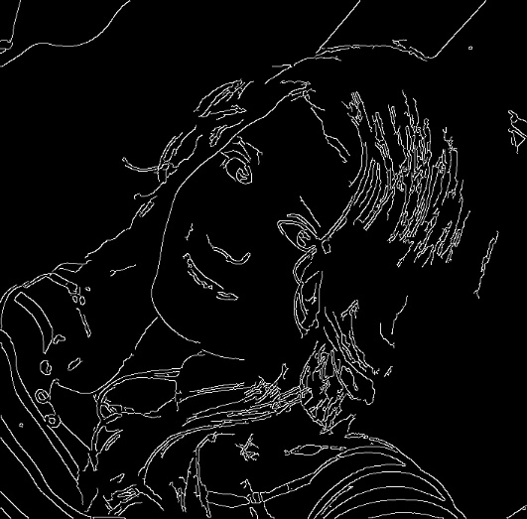
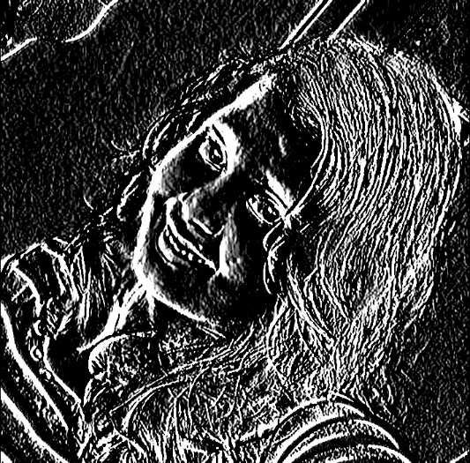
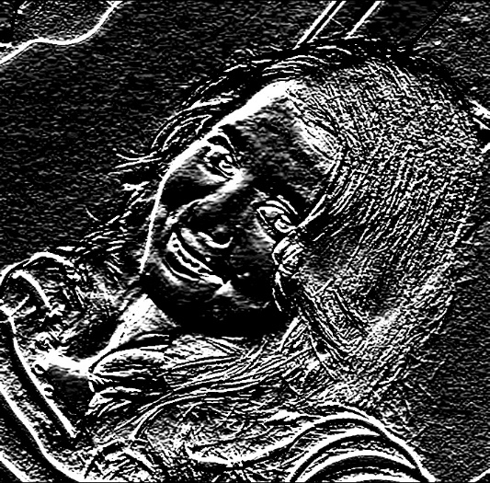
Edge detection
Canny edge detector
sobel edge detector
X-axis derivative
Y-axis derivative

Slide 16
INTEREST POINT/KEY POINT DETECTION IN FACIAL IMAGES
Harris Corner Point Detection
Scale Invariant Feature Transform (SIFT)
Speeded Up Robust Feature (SURF)
Histogram Oriented Gradient (HOG)

Slide 17
Harris Corner Point Detection
The Harris Corner Detector is a mathematical operator that finds features in an image. It is simple to compute and is fast enough to work on computers. Also, it is popular because it is rotation, scale and illumination variation independent. A sliding window is hovered over the image and corner point i.e. Key Points, is detected within that window by taking derivative. Shifting the window in any direction gives a large change in intensity.

Slide 18
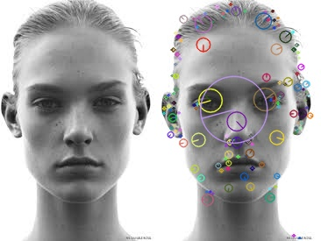
Scale Invariant Feature Transform (SIFT)
Harris Corner Detector is Rotation invariant, which means, even if the image is rotated, we can find the same corners but it is not Scale Invariant. Scale Invariant Feature Transform (SIFT) extracts Distinctive Image Features from Scale-Invariant Key points, which extract key points and compute its descriptors. SIFT is invariance to scale and rotation as well as it is robust to Noise.
Scale Space Peak selection
Key Point Localization
Orientation Assignment
Key point descriptor

Slide 19
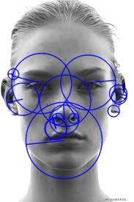
Speeded Up Robust Feature (SURF)
In computer vision, speeded up robust features (SURF) is a patented local feature detector and descriptor. It can be used for tasks such as object recognition, image registration, classification or 3D reconstruction. It is partly inspired by the scale-invariant feature transform (SIFT) descriptor. The standard version of SURF is several times faster than SIFT and claimed by its authors to be more robust against different image transformations than SIFT.
METHOD | SURF
NO OF KEY POINTS DETECTED BEFORE THRESHOLD | 163
HESSIAN THRESHOLD | 100
NO OF KEY POINTS AFTER THRESHOLD | 14

Slide 20
Week 2
Key Point Matching
Object Detection
Face Detection

Slide 21
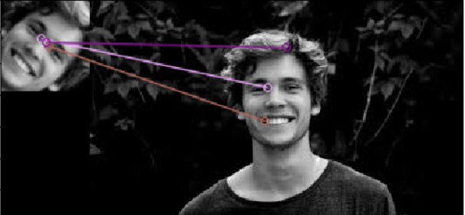
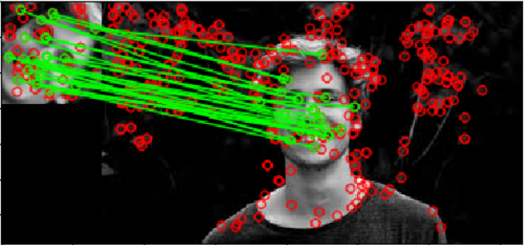
Key point matching
Using SIFT & BRUTE-FORCE
Using SIFT & FLANN
No of key points | 345
No of matching points | 3
No of key points | 345
No of matching points | 65

Slide 22
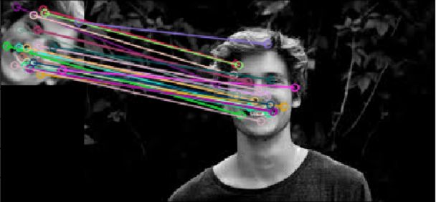
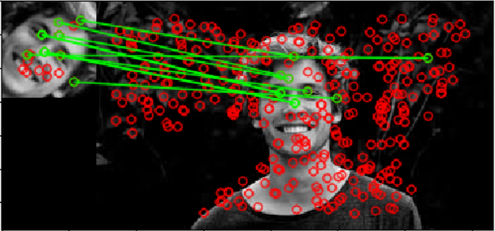
Using SIFT & Ratio-Test:
Using SURF & FLANN
No of key points | 345
No of matching points | 60
No of interest points | 316
No of matching points | 21

Slide 23
OBJECT DETECTION
Object detection is the process of finding instances of real-world objects such as faces, bicycles, and buildings in images or videos. Object detection algorithms typically use extracted features and learning algorithms to recognize instances of an object category. Feature-based object detection
For this project, we have used a model in which SURF is used for key point extraction and KNN (K-Nearest Neighbour) is used for classification. A template image is given and it is compared with real time image for detection

Slide 24
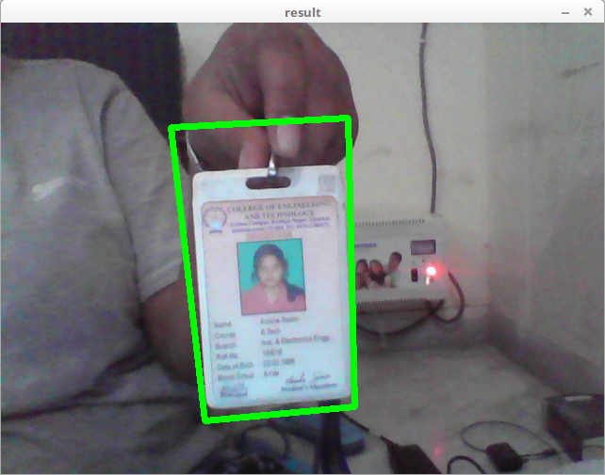
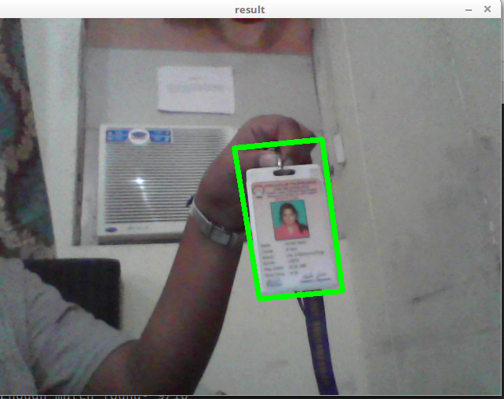

Slide 25
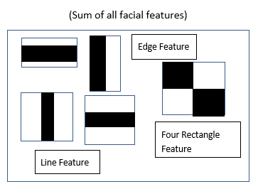
FACE DETECTION USING HAAR CASCADE
Object detection using Haar Cascade feature based cascade classifiers is an effective object detection technique.
The algorithm needs a lot of positive and negative images to train the classifiers. Haar features are just like the convolutional kernel. Each feature is obtained as a single value by subtracting sum of pixels under white/black rectangle

Slide 26
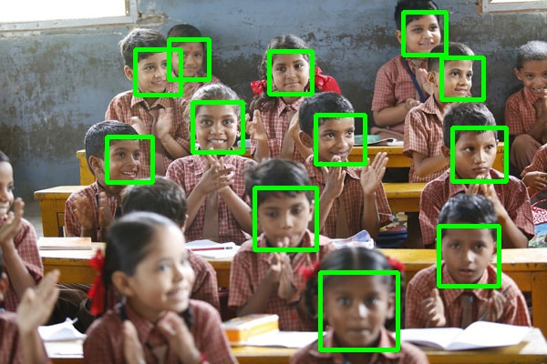
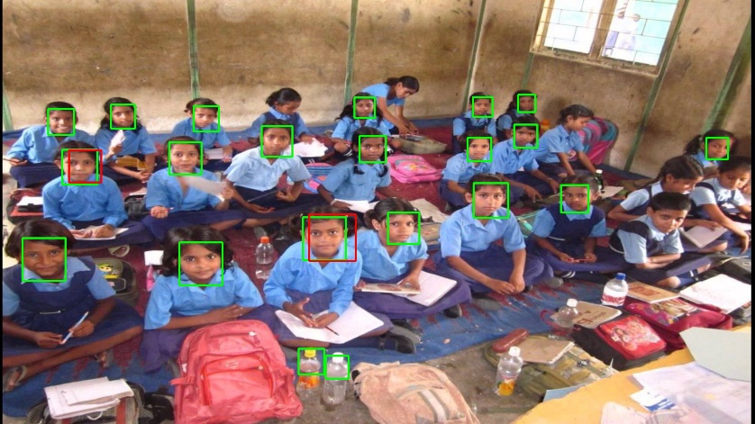
Haar Cascade has pre-trained xml files for face detection and we used frontal and side faces training files for both front and side face detection.

Slide 27
Week 3
Landmark Feature Extraction
Study About Different Machine Learning Classifiers

Slide 28
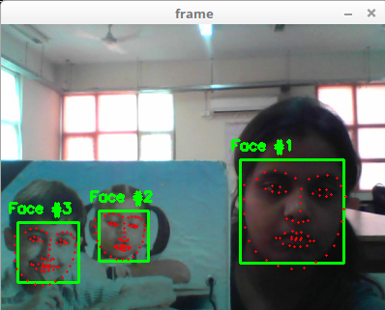
LANDMARK FEATURE EXTRACTION FROM FACIAL IMAGE
In this project, we implemented an approach for detecting face and facial features such as eyes, nose, and mouth in real time and from images. We make use of thresholding and connected component labelling algorithm to detect a face and extract features that characterize the face. This approach has the advantage that no manual interaction is required for choosing and extracting components.

Slide 29
Machine Learning Classifiers
Machine learning is an application of artificial intelligence (AI) that provides systems the ability to automatically learn and improve from experience without being explicitly programmed. Machine learning focuses on the development of computer programs that can
Machine learning algorithms are often categorized as supervised or unsupervised.
Supervised machine learning
Semi-supervised machine learning algorithms
Reinforcement machine learning algorithms

Slide 30
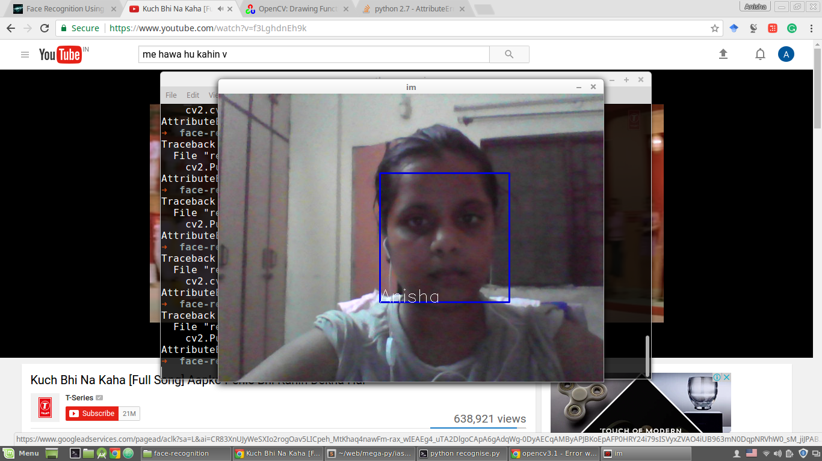
With Haar Cascade (lbp )
Local binary patterns (LBP) is a type of visual descriptor used for classification in computer vision.
The algorithm is divided into 3 steps.1)Dataset Creation 2)Training 3)Recognition
Dataset Creation:
Faces were detected in real time and frame by frame recognized images were extracted. The images were stored in a folder named “dataset”. Every image in the dataset was given an Id number according to different persons.
Training :
The images were trained with that id number for different persons with different Id and a “.yml” training file was created.
Face Recognition:
By Haar Cascade again the face is detected and by using the trained “.yml” file, the Id of the detected face is recognized.
The Accuracy of this algorithm was found to be 40-42%.

Slide 31
With PCA + SVM on LFW- Funnelled Dataset
Principal component analysis (PCA) is a statistical procedure that uses an orthogonal transformation to convert a set of observations of possibly correlated variables into a set of values of linearly uncorrelated variables called principal components
A Support Vector Machine (SVM) is a discriminative classifier formally defined by a separating hyperplane. In other words, given labeled training data (supervised learning), the algorithm outputs an optimal hyperplane which categorizes new examples.
Labelled Faces in the Wild (LFW), a database of face photographs designed for studying the problem of unconstrained face recognition. The data set contains more than 13,000 images of faces collected from the web

Slide 32
With OpenFace (Deep Learning)
Open-Face is a Python and Torch implementation of face recognition with deep neural networks and is based on the CVPR 2015 paper FaceNet: A Unified Embedding for Face Recognition and Clustering by Florian Schroff, Dmitry Kalenichenko, and James Philbin at Google. Torch allows the network to be executed on a CPU or with CUDA.
Detected faces with pre-trained models from dlib or OpenCV.
Transformed the face for the neural network. This repository uses dlib's real-time pose estimation with OpenCV's affine transformation to try to make the eyes and bottom lip appear in the same location on each image.
Used a deep neural network to represent (or embed) the face on a 128-dimensional unit hypersphere. The embedding is a generic representation of anybody's face. Unlike other face representations, this embedding has the nice property that a larger distance between two face embedding means that the faces are likely not of the same person. This property makes clustering, similarity detection, and classification tasks easier than other face recognition techniques where the Euclidean distance between features is not meaningful.
Applied HOG & SVM favorite classification techniques to the features to complete recognition task.

Slide 33


SUBJECT NAME | No of training Image | Accuracy
Ashutosh | 27 | Not predicted correctly
Manaswini | 40 | 64%
Chiranjeev | 44 | 89%
Chaya | 50 | 53%
Shaswat | 20 | 69%
Raghavendra | 42 | 50%
SUBJECT NAME | No of training Image | Accuracy
Ashutosh | 59 | 50%
Manaswini | 40 | 64%
Chiranjeev | 44 | 89%
Chaya | 50 | 53%
Shaswat | 20 | 69%
Raghavendra | 42 | 50%

Slide 34
SUBJECT NAME | No of training Image | Accuracy
Ashutosh | 25 | Not predicted correctly
Manaswini | 20 | 65%
Chiranjeev | 22 | 88%
Chaya | 20 | 52%
Shaswat | 20 | 69%

Slide 35
Week 5-8
Gait Recognition
Implementation of DDR with Kinect
Trajectory parameter estimator

Slide 36
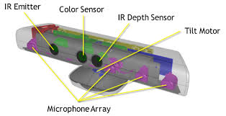
BASICS OF MICROSOFT KINECT
Kinect is Microsoft’s motion sensor add-on for the Xbox 360 gaming console. The device provides a natural user interface (NUI) that allows users to interact intuitively and without any intermediary device, such as a controller.

Slide 37
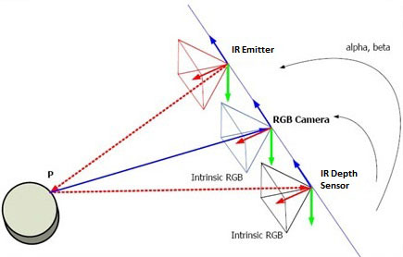
Working
For some colored object and background, Kinect uses its IR projector and creates a matrix. 1st camera points towards 1 pixel of the matrix and the second camera follow the points of camera 1, which form a triangle. The height of the formed triangle is considered as the distance of the object from Kinect

Slide 38
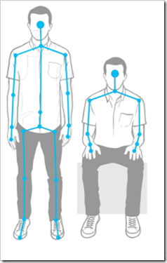
Skeleton Data Extraction
Skeletal Tracking allows Kinect to recognize people and follow their actions. Using the infrared (IR) camera, Kinect can recognize up to six users in the field of view of the sensor. Of these, up to two users can be tracked in detail. An application can locate the joints of the tracked users in space and track their movements over time.
In default range mode, Kinect can see people standing between 0.8 meters (2.6 feet) and 4.0 meters (13.1 feet) away; users will have to be able to use their arms at that distance, suggesting a practical range of 1.2 to 3.5 meters.

Slide 39
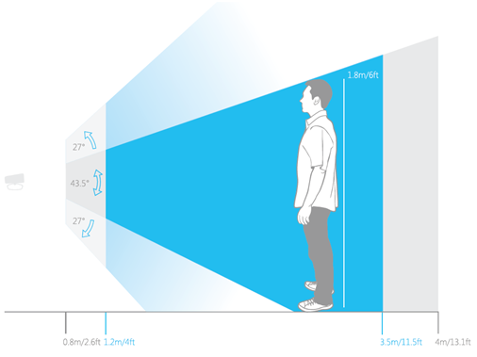
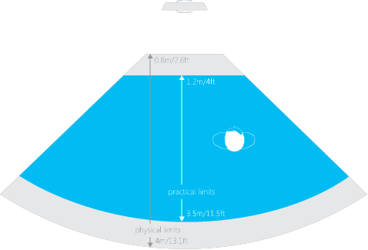
It can detect skeleton of maximum 2 people
Skeleton tracking is generally designed to recognize user facing the sensor

Slide 40
Systems facilitating robust, automatic identification of persons have gained increasing acceptance during the recent years. Systems for automatic identification play a decisive role in surveillance scenarios (e.g., monitoring high-security areas like banks or airports). Biometric techniques use characteristic physiological and behavioral specifics of different persons for identification. Examples of such techniques are the recognition of iris, face, fingerprint, gait, or the handwriting. Gait recognition is a relatively new biometric technique. Using gait as a biometric gained increasing attention during the past years since it offers many advantages compared to other biometrics. Considering marker-free systems, (i.e., no sensors or other devices are placed on the subject being identified), gait recognition is an uninstructive technique, meaning that no physical contact between subject and measurement device is necessary. In marker-free gait recognition, person identification is usually executed by analysing video sequence recordings. Allowing for marker-free person identification is one of the key advantages of using gait as a biometric surveillance system.

Slide 41
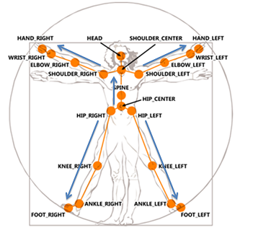
skeleton joint position extraction
Joint Positions
Joint Angles
Velocity of a particular joint
Distance between two joints

Slide 42
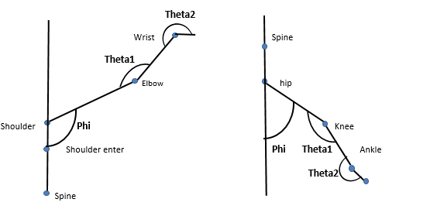

Slide 43
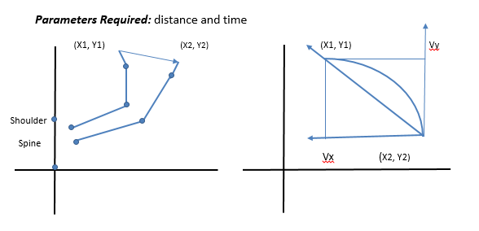
Velocity Calculation

Slide 44
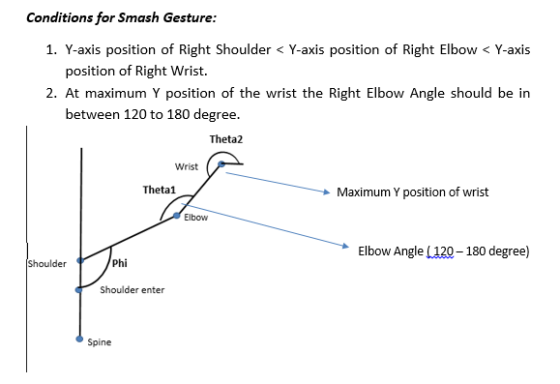
GESTURE RECOGNITION (Smash Gesture)

Slide 45
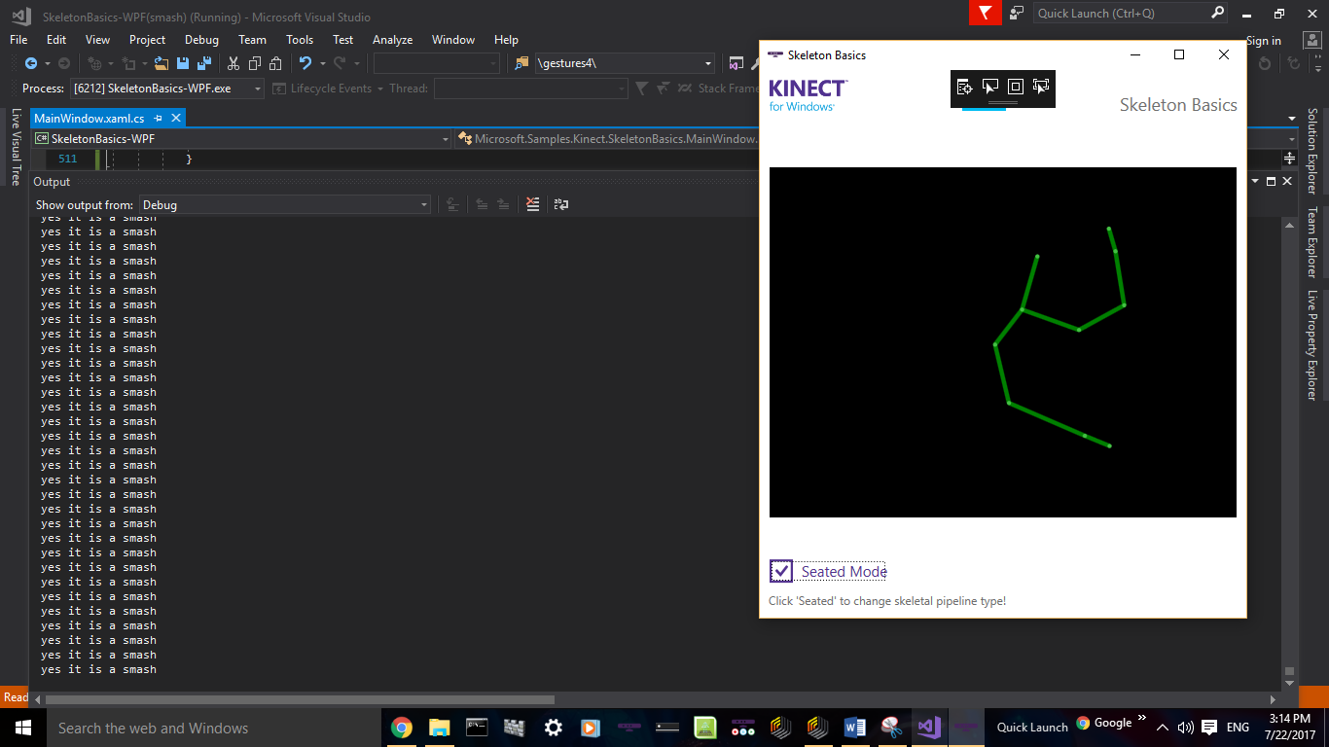

Slide 46
GESTURE COMPARISION
Gesture recognition may find applications in rehabilitation systems, sign language translation or smart environments. The aim of nowadays science is to improve the recognition systems' efficiency but also to allow the user to perform the gesture in a natural way. For gesture recognition, one more important aspect is a comparison between two gestures.
However, we tried to compare different gestures with correlation factor.
Correlation Factor:
Correlation Factor is also known as correlation coefficient. It is a statistical measure of the degree to which, changes to the value of one variable predict the change to the value of other.
Correlation factors are expressed between -1 to 1

Slide 47
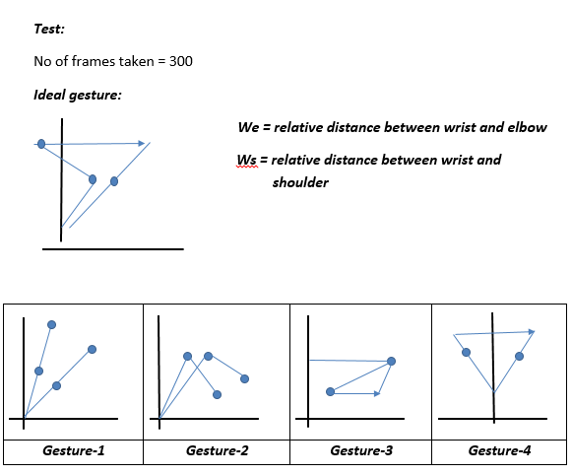

Slide 48
Calculation of Correlation
 |  | Gesture-1 | Gesture-2 | Gesture-3 | Gesture-4
Angle with Kinect 0 degree | Phi | 0.6159 | 0.101 | 0.048 | 0.255
 | Theta1 | -0.063 | 0.182 | -0.121 | 0.233
 | Theta2 | 0.195 | 0.01 | 0.443 | 0.451
 | We | 0.5783 | -0.35858 | 0.331 | -0.183
 | Ws | 0.31129 | -0.792 | 0.535 | 0.001
Angle with Kinect 45 degree | Phi | 0.6525 | -0.2424 | 0.334 | 0.374
 | Theta1 | -0.0813 | -0.0348 | -0.228 | -0.08
 | Theta2 | 0.5912 | -0.25789 | 0.0497 | -0.370
 | We | -1.215 | 0.1543 | 0.0244 | -0.076
 | Ws | -0.065 | 0.168 | 0.082 | -0.04
Angle with Kinect 0 degree

Slide 49
GAIT RECOGNITION
The main goal of this project is to assess the viability of using Kinect’s data to create a biometric identification system. In particular, we are interested in using static anthropometric measurements (i.e. without considering motion) for this purpose, but without requiring subjects to stand still in front of the sensors (so that the system is fully passive). Specific goals include: (I) apply and test different machine learning algorithms to train classifiers; (ii) compare the difficulty of identifying multiple (iii) identify relevant attributes to perform an accurate identification.
Data Capture and Pre-Processing our approach starts by capturing data from different volunteers. In this project, we took data results from 10 volunteers (8 female and 2 male) and without (noticeable) physical problems. The Kinect provides frames containing information from its sensors, at a rate of 30 frames per second. We only used data regarding the captured skeleton, which is composed of 32 features. This data was captured while subjects walked in front of the sensor.

Slide 50
Features:
Right Hand Length 18.Right ankle angle
Right Wrist to Elbow Length 19.Left leg length
Right Elbow to Shoulder Length 20.Left hip to knee length
Right Hand Angle (Phi) 21.Left knee to ankle length
Right Elbow Angle (Theta-1) 22.Left leg angle
Right Wrist Angle (Theta-2) 23.Left knee angle
Left Hand Length 24.Left ankle angle
Left Wrist to Elbow Length 25.Head to shoulder centre length
Left Elbow to Shoulder Length 26.Shoulder centre to spine length
Left Hand Angle (Phi) 27.Spine to Hip length
Left Elbow Angle (Theta-1) 28.Body velocity
Left Wrist Angle (Theta-2) 29.Right-hand velocity
Right leg length 30.Left-hand velocity
Right hip to knee length 31.Right leg velocity
Right knee to ankle length 32.Left leg velocity
Right leg angle
Right knee angle

Slide 51
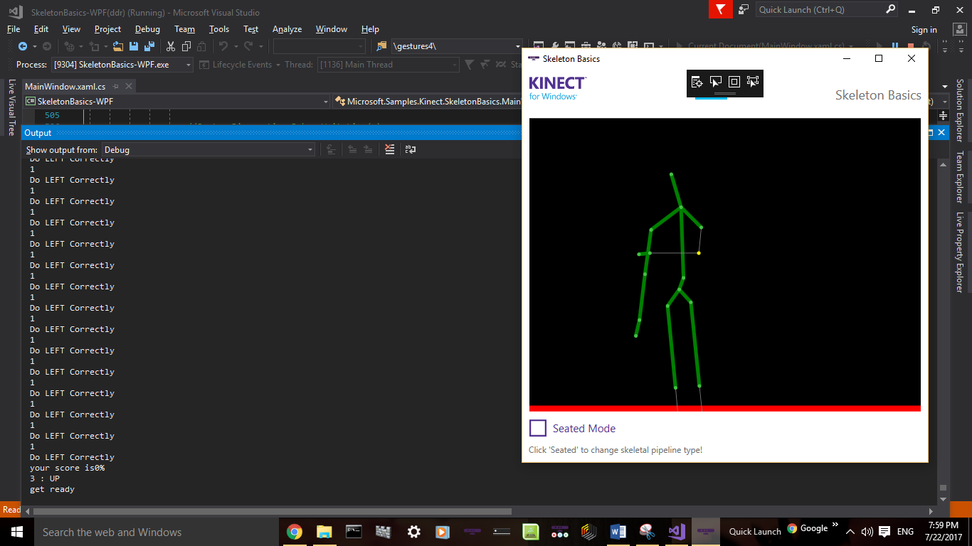
DDR implementation of Kinect for visually impaired people
Adults with blindness or low vision are substantially more likely to report poor, fair, or worsening health compared to the general. Two things that may contribute to this inferior health are being overweight or obese and not being physically active. So this system can also contribute towards their health as it is a very effective form of exercise.

Slide 52
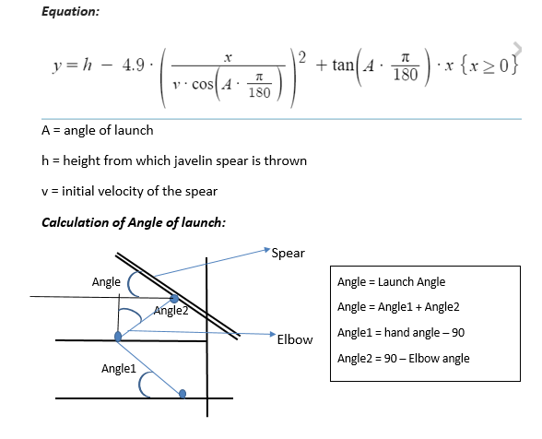
prediction of trajectory and maximum distance from JAVELIN throw gesture

Slide 53
FUTURE WORK:
The future work proposed for this project is to add visualization to the DDR system and to make the algorithm more robust. Generation of sound instead of playing sound track will be beneficial and will decrease computing time.
Future work to be done in trajectory calculation project is make the algorithm more robust for better accuracy of prediction of maximum distance of throw and real time testing of the distance.
The primary goal of the gait recognition system is to achieve a higher accuracy and to improve robustness of the system. The future work to be done on this project is the integration of face recognition system & voice recognition to the Kinect sensor itself so that these system can work together on one platform

Slide 54

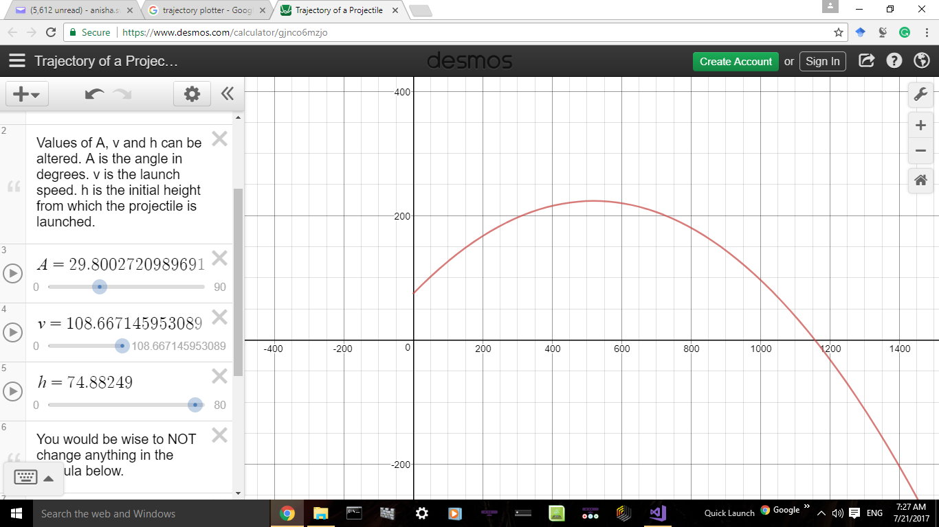

Slide 55
Thank You

